Slide 1
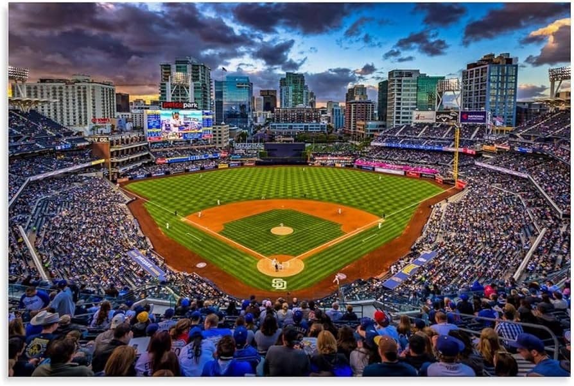
Baseball & Softball
Lineup Optimization
System
Kali Javetski & Sylvia Burroughs
CSC-343 AI · Spring 2026

Slide 2
The Problem
Coaches make lineup decisions before every game —
who plays where, and who bats when.
Nine positions to fill, with players who can only play certain spots
Batting order affects run production across all nine innings
Matchups against the opposing pitcher change the calculus every game
Mid-game substitutions add another layer of real-time decisions

Slide 3
Our System
A five-module pipeline — each stage feeds the next
Stats
Input
FOL
M1
Knowledge
Base M2
CSP
M3
Genetic
Alg. M4
Planning
M5
Final
Lineup
CSV / JSON
Matchup scores
Defensive scores
Field assignment
Batting order
In-game moves
Ready to play
Every module exposes its reasoning — rules fired, constraints satisfied, fitness values, tactical reasons.

Slide 4
Demo
Dashboard walkthrough

Slide 5
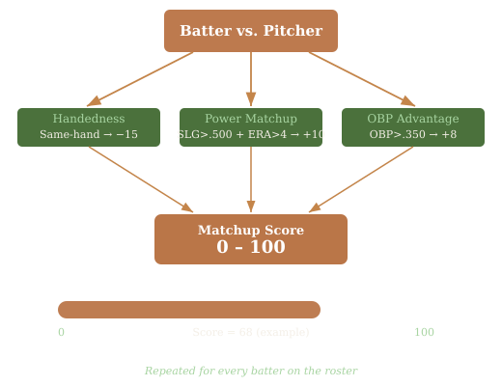
Module 1 — First-Order Logic
How good is this batter against today’s pitcher?
Quantified if/then rules over batter & pitcher stats — handedness, OBP, SLG, ERA
Produces a 0–100 matchup score for every batter, no prior head-to-head data needed

Slide 6
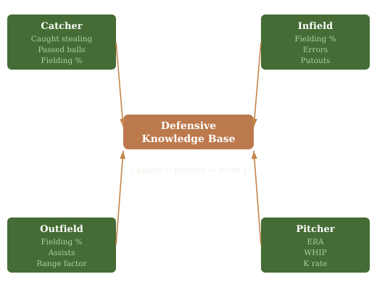
Module 2 — Knowledge Base
Who is actually good at each position?
Position-specific rule sets — catchers judged on caught stealing, outfielders on range
Outputs a score matrix: every player rated at every eligible position

Slide 7
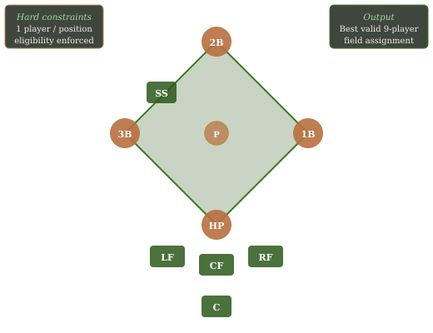
Module 3 — Constraint Satisfaction
Who plays where — legally, and as well as possible?
Hard constraints enforced: one player per position, eligibility respected
Backtracking search with MRV heuristic; optimizes blended offense + defense score

Slide 8
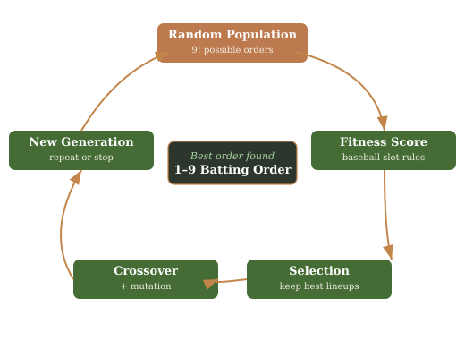
Module 4 — Genetic Algorithm
What’s the best batting order for these nine players?
9! = 362,880 possible orders — evolves good lineups across generations
Fitness rewards table setters early (OBP), power in the middle (SLG/HR)

Slide 9
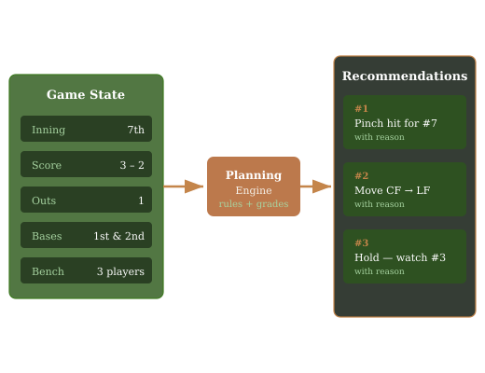
Module 5 — Planning
What should we do right now, given the score and the bench?
Reads live game state: inning, score, outs, bases, substitution limits
Returns ranked, explainable recommendations — pinch hit, defensive swap, outlook

